Slide 1

Department of Computer Science & Engineering SCHOOL MANAGEMENT SYSTEM 1. 2411CS010673(P. HARI KRISHNA) 2. 2411CS010703(L.SHIVA NAGA SAI) 3. 2411CS010704(K.ANIRUTH) 4. 2411CS010709(P.PAVANI) 5. 2411CS010719(K.VIJAY KUMAR)
Maisammaguda, Kompally, Medchal - Malkajgiri District Hyderabad - 500100, Telangana State. www.mallareddyuniversity.
(Telangana State Private Universities Act No. 13 of 2020 &
G.O.Ms. No. 14, Higher Education (UE) Department)

Slide 2
Table of Contents
Abstract
Introduction
Limitations of Existing Systems
Literature survey
Proposed system
Existing system
Data flow diagram
System architecture
Hardware and software requirements
Screenshots of working model
Results
Conclusion

Slide 3
ABSTRACT
A School Management System is a modern digital solution designed to simplify and improve the overall management of school operations. It helps schools maintain accurate information about students, teachers, examinations, fees, and academic records in a centralized database. By replacing traditional paper-based processes with a computerized system, it reduces manual work, minimizes errors, saves valuable time, and increases the efficiency of daily administrative activities. The system provides quick and secure access to information, making school management more organized, reliable, and effective.
The system also enables secure storage and easy retrieval of important data such as student profiles, staff details, records, examination results, fee management, timetable, and report generation. It allows authorized users to update records, monitor school activities, and generate reports with greater accuracy and transparency. Overall, the School Management System improves administrative efficiency, enhances data security, supports better communication between students, teachers, parents, and administrators, and creates a smart, user-friendly, and technology-driven environment for effective school management.

Slide 4
INTRODUCTION
The School Management System (SMS) is a web-based application designed to simplify and automate the daily activities of a school. It helps manage student records, teacher information, examinations, and academic activities efficiently.
The system allows administrators, teachers, students, and parents to access important information through a simple and user-friendly interface. Students can view their academic records, exam results, and other school-related details.
Administrators can manage student admissions, teacher records, class schedules, examinations, fee collection, and generate reports for effective school administration and better decision-making.
The School Management System replaces manual paperwork with a secure, centralized, and digital solution, improving accuracy, efficiency, transparency, and productivity in educational institutions .
Additionally, the system provides secure data storage, quick access to school information, real-time updates, easy report generation, and efficient communication between administrators, teachers, students, and parents, ensuring smooth and reliable school management.

Slide 5
LIMITATION OF EXISTING SYSTEM
Most traditional School Management Systems rely on manual processes or outdated software for managing student, teacher, examination, and fee records. These systems often lead to data duplication, delays, human errors, and inefficient management of school activities.
☐ Manual and time-consuming management of school records
☐ Difficulty in maintaining student, teacher, and staff information
☐ High chances of human errors during data entry and record updates
☐ Difficult to search, update, and retrieve information quickly
☐ No real-time access to examination, and fee details
☐ Limited security and lack of proper data backup facilities
These limitations reduce the efficiency, accuracy, security, and overall performance of school administration, making it difficult to manage daily academic and administrative activities effectively.

Slide 6
LITERATURE SURVEY
Existing School Management Systems mainly focus on student records, admission management, staff information, examination details, and fee management .
Most traditional systems provide basic record management and reporting features but lack real-time updates, automation, centralized communication, and advanced security.
Recent advancements in Cloud Computing, Database Management Systems (DBMS), Web Technologies, and JavaScript-based applications enable faster student registration, online fee management, timetable scheduling, and easy access to school information.
However, existing solutions do not effectively combine:
1. Online student admission and registration
2. Real-time attendance and academic record updates
3. Fee management, examination, and report generation
4. Secure role-based access for Admin, Teachers, Students, and Parents
Our system integrates these features into a single, user-friendly, secure, reliable, and scalable School Management System platform that simplifies school administration and improves communication between administrators, teachers, students, and parents.

Slide 7
PROPOSED SYSTEM
The proposed system, School Management System (SMS), is a web-based application designed to simplify and automate the management of school activities. It overcomes the limitations of traditional manual record-keeping by providing a secure and efficient platform for managing student, teacher, and administrative information. The system enables centralized data storage, real-time access to records, and improves the overall efficiency, accuracy, and transparency of school operations.
☐ Student admission and registration with complete personal and academic details
☐ Easy Add, Update, Delete, and Search for student, teacher, and staff records
☐ Secure login and role-based authentication for administrators, teachers, and students
☐ Centralized storage of school information for better organization and quick access
☐ Automatic report generation for student performance, attendance, and school activities
The proposed system ensures accuracy, security, transparency, and efficient management of school records while reducing paperwork, saving time, and improving the overall administration process.

Slide 8
EXISITING SYSTEM
The existing School Management System is mostly based on manual record-keeping or basic digital tools such as paper registers, spreadsheets, and standalone applications. School staff manually maintain student admissions, attendance, teacher records, examination details, fee information, and academic data. This process is time-consuming and increases the chances of human errors, duplicate records, missing information, and data inconsistency.
In addition, traditional systems do not provide centralized data management, automation, or real-time access to school records. They lack features such as quick search, automatic report generation, secure data storage, online attendance management, and easy updating of student and staff information. Most existing systems also have limited scalability and do not support efficient communication between administrators, teachers, students, and parents. As a result, these limitations reduce administrative efficiency, make school management difficult, and delay decision-making in educational institutions.

Slide 9
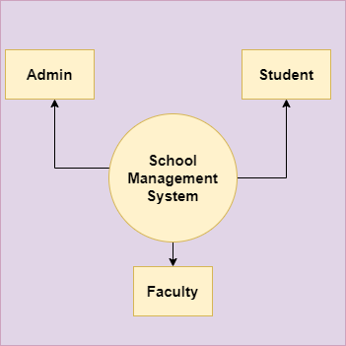
DATA FLOW DIAGRAM

Slide 10
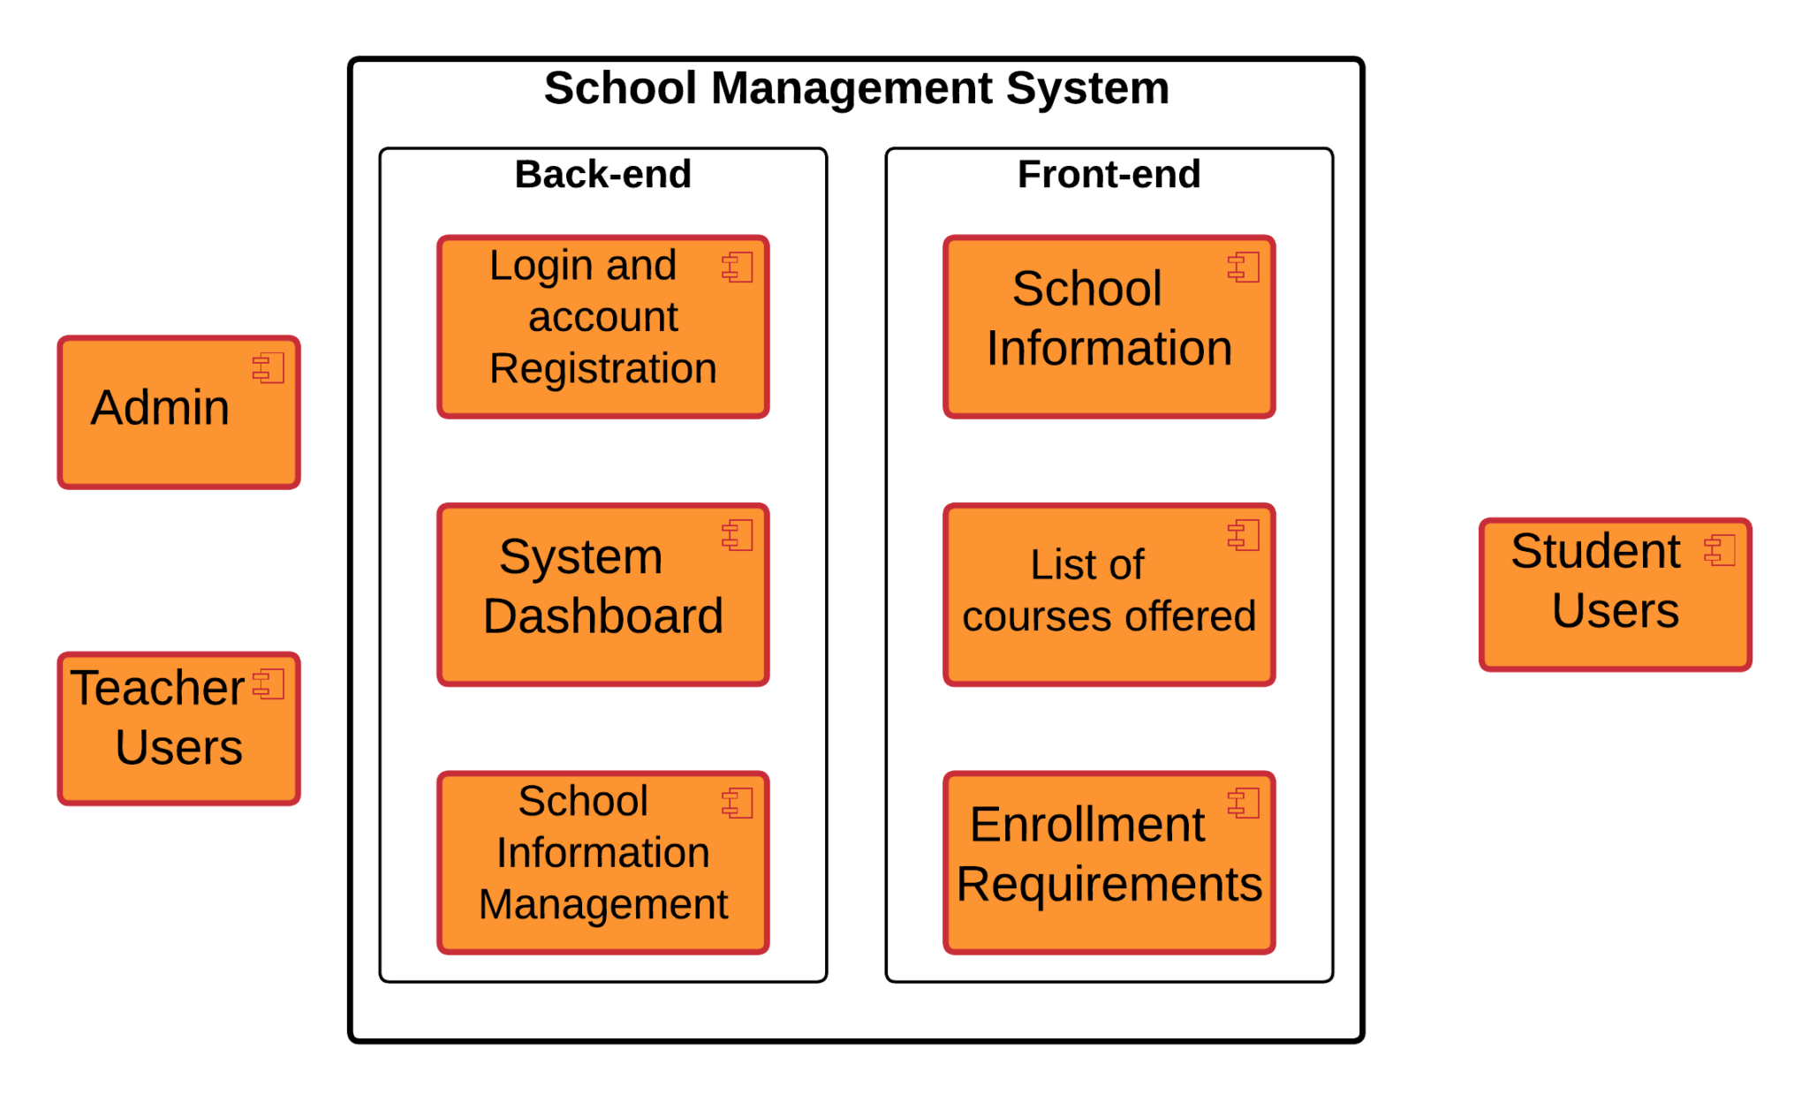
SYSTEM ARTICHITECTURE

Slide 11
HARDWARE AND SOFTWARE REQURIMENT
Hardware Requirements:
Processor: Intel Core i3 or higher
RAM: 4 GB minimum (8 GB recommended)
Storage: 100 GB free disk space
Display: 1366 × 768 resolution
Input Devices: Keyboard and Mouse
Internet Connection: Required for online access, updates, and data synchronization
Software Requirements:
Frontend: HTML5, CSS3, JavaScript
Backend: JavaScript (Node.js with Express.js)
Database: MySQL
Operating System: Windows 10/11, Linux, or macOS
Web Browser: Google Chrome, Mozilla Firefox, or Microsoft Edge
Development Tool: Visual Studio Code (VS Code)
Version Control: Git (Optional)
Runtime Environment: Node.js

Slide 12
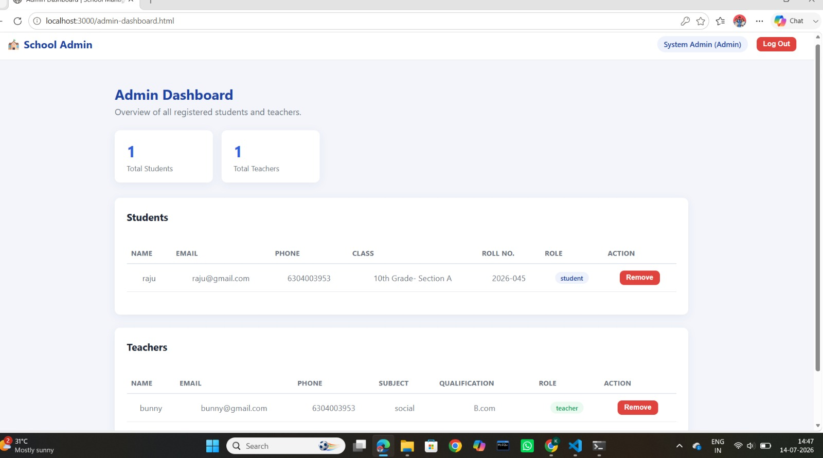
SCREEN SHOTS

Slide 13
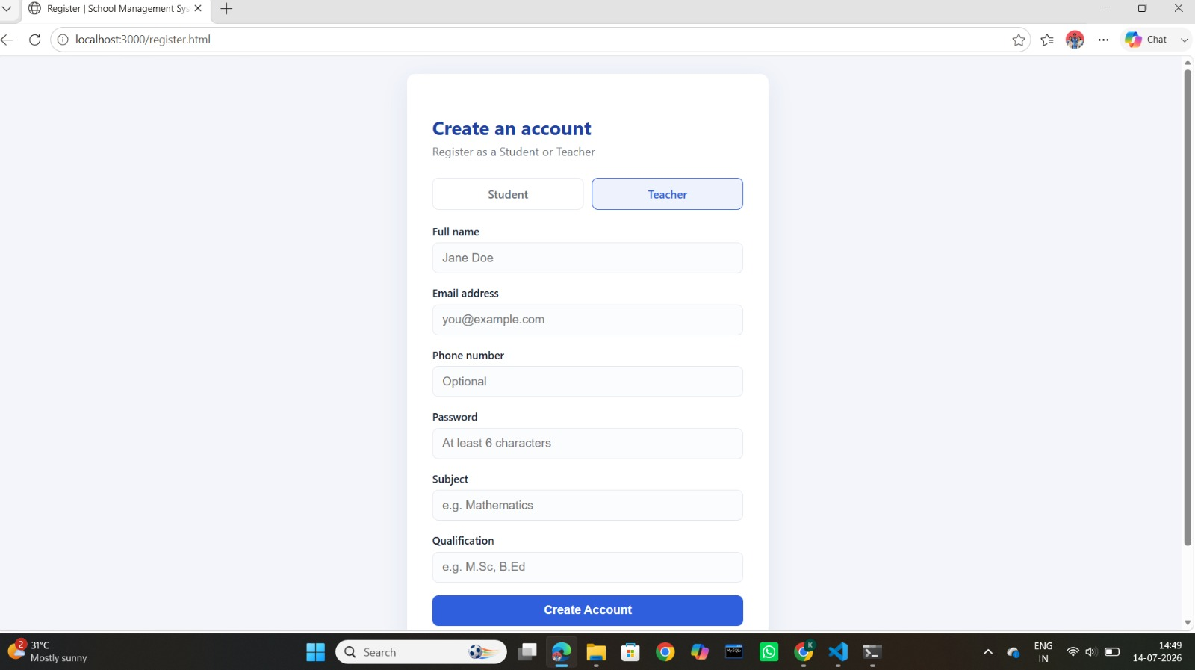
SCREEN SHOTS

Slide 14
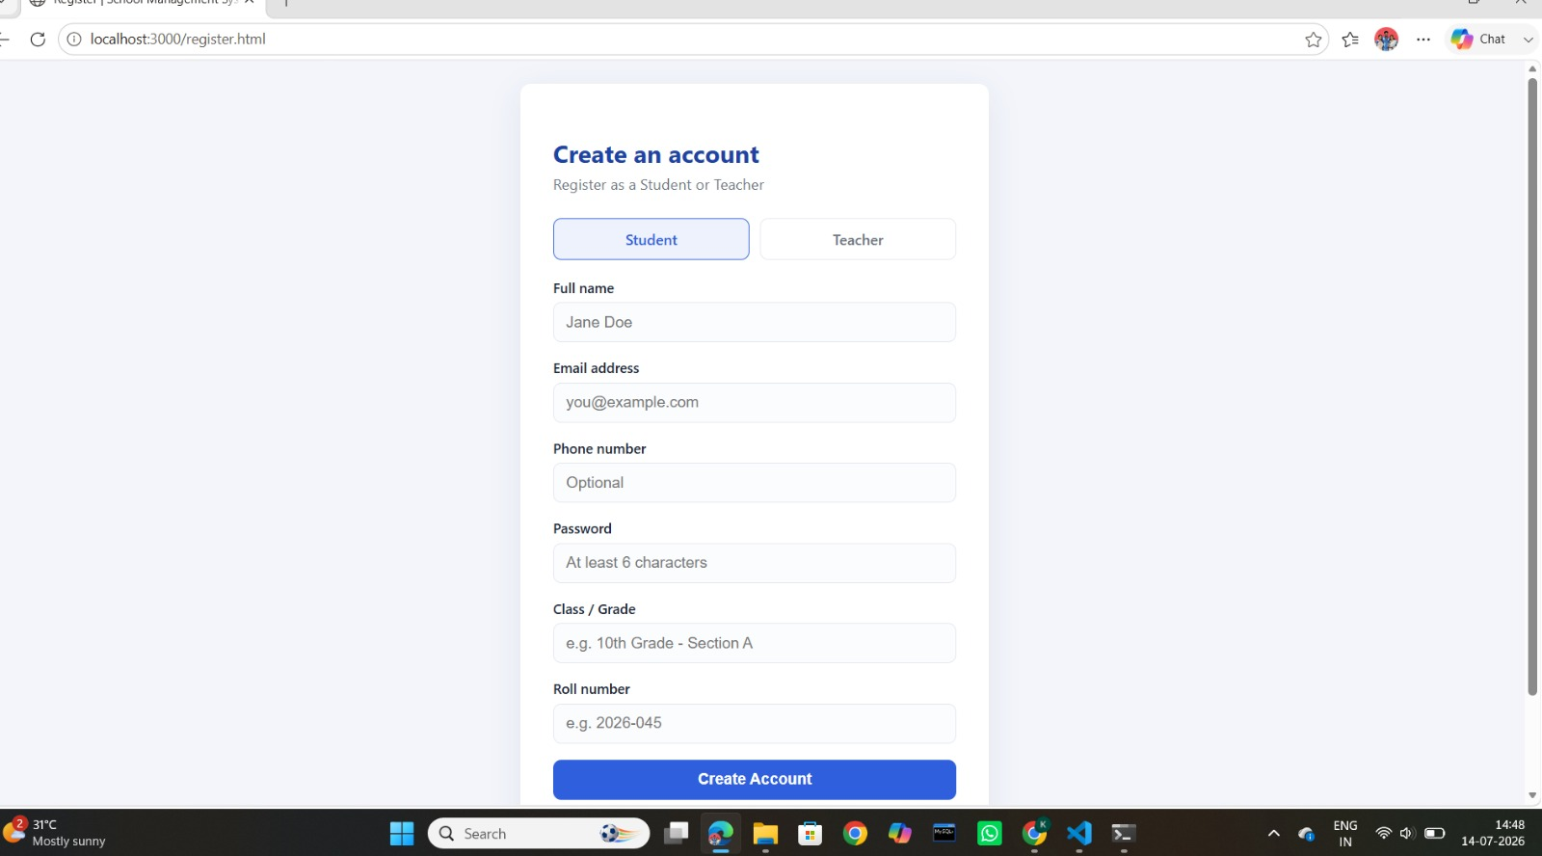
SCREEN SHOTS

Slide 15
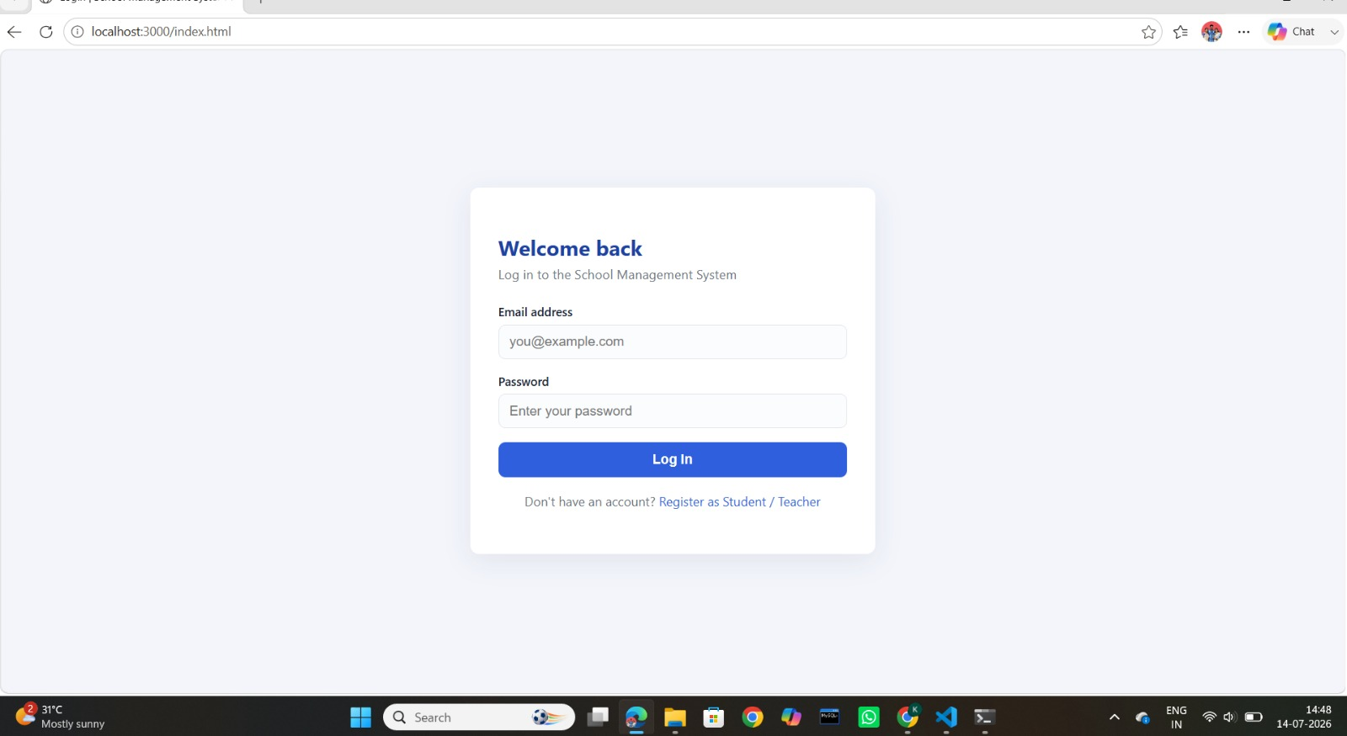
SCREEN SHOTS

Slide 16
CONCULSION
The School Management System (SMS) is a simple and efficient application designed to manage school activities digitally and reduce manual paperwork.
It allows administrators to manage student records, teacher details, examinations, fees, and other school information quickly and accurately.
The system helps maintain student admissions, academic records, staff information, and administrative data in a secure and well-organized database.
With secure login and role-based access, it ensures that only authorized users can access and manage school information, improving data security.
The system improves accuracy, reduces data redundancy, saves time, and automates daily school management tasks, making operations more efficient.
Overall, the School Management System enhances efficiency, transparency, and reliability, making school administration easier and improving the overall management of educational institutions.

Slide 17
THANK YOU

